Slide 1
CS 169
Software Engineering
Armando Fox, David Patterson,
and Koushik Sen
Spring 2012
Notes:
earliest ever lecture prep! aug 4
follow along download slides

Slide 2
Outline
Class Organization (AF)
Engineering SW is Different from HW
(Book Sections 1.1-1.2 or §1.1-§1.2)
Development Processes: Waterfall vs. Agile (§1.3)
Assurance (§1.4)
Productivity (§1.5)
Software as a Service (§1.6) if time permits
Service Oriented Architecture (§1.7) if time permits
Cloud Computing (§1.8) if time permits

Slide 3
Course Goals
Understand new challenges, opportunities, and open problems of SaaS relative to SWS (shrink-wrapped software)
Take a SaaS project from conception to public deployment
  Server side: Ruby on Rails
  Client side: HTML, CSS, AJAX
  Deploy using cloud computing
Can be “connected” app (eg Facebook ) or smartphone app (using HTML/AJAX/CSS)

Slide 4
Prereqs & course format
4 units, letter grade(see homepage for breakdown)
These are real prereqs: CS61[ABC] or equivalents
Format
  Before lecture: reading, and sometimes online self-test
  In lecture: put reading in context
  After lecture: 6 homeworks, for hands-on practice; section for additional detail & worked examples
5 30-minute quizzes (every 2 weeks); no final
Required “2-pizza team” project
  Design, develop, deploy to “production ISP” (Heroku)
  Outsiders invited (VC’s, etc) to final demos
  Many projects have continued after the class
Notes:
functional programming, map/filter, higher-order programming

Slide 5
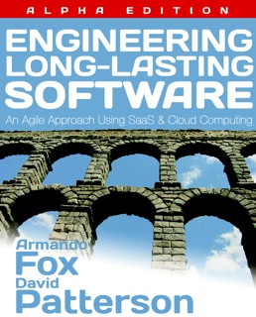
Textbook
http://saasbook.info
Print & Kindle ebook
available
2-3 new chapters will be released during semester
Kindle ebooks will get free updates thru Fall 2012
We’ll distribute hardcopy of additional chapters to you
Notes:
mention Berkeley on-campus students will receive hardcopy of extra chapters

Slide 6
Online SaaS Course
First 5 weeks of on-campus course
We will use their autograding technology for grading CS 169 homeworks
Available 5 weeks after our course starts
Please delay questions until end of “segment”, which is typically 6 to 10 minutes

Slide 7
Programming Homeworks
Some done on your own, others in pairs
Due Friday Midnight (see Syllabus)
  Late policy: ¾ credit if 1 day late, ½ credit if 2 days late, 0 if later
Can be done on your own computer or Amazon EC2
  Download VirtualBox (for Mac, Win, Linux) and deploy "bookware VM" image (instructions on saasbook.info)
  OR, deploy & use VM image on Amazon EC2 (instructions coming soon to saasbook.info) - http://aws.amazon.com/free/
  Unsupported: install ALL courseware on your own computer (Ruby 1.9.2, Rails 3.1, lots of libraries...) – see saasbook.info for details
Later HW’s and Project will be deployed using cloud computing (details TBA)

Slide 8
Course Organization
Grading
  1/3 - six homeworks
  1/3 - five quizzes (30 mins, in-class)
  1/3 - project
  Discretionary bonus points during final grading: Participation and Altruism
A typical week
  Tue/Thu: lecture, office hours
  Fri 11:59pm: homework due
  Mon: section—discuss HW, review for quizzes
Use Piazza for questions/discussion
Spring 2011 -- Lecture #1

Slide 9
YOUR BRAIN ON COMPUTERS; Hooked on Gadgets, and Paying a Mental Price
NY Times, June 7, 2010, by Matt Richtel
SAN FRANCISCO -- When one of the most important e-mail messages of his life landed in his in-box a few years ago, Kord Campbell overlooked it.
Not just for a day or two, but 12 days. He finally saw it while sifting through old messages: a big company wanted to buy his Internet start-up.
''I stood up from my desk and said, 'Oh my God, oh my God, oh my God,' '' Mr. Campbell said. ''It's kind of hard to miss an e-mail like that, but I did.''
The message had slipped by him amid an electronic flood: two computer screens alive with e-mail, instant messages, online chats, a Web browser and the computer code he was writing.
While he managed to salvage the $1.3 million deal after apologizing to his suitor, Mr. Campbell continues to struggle with the effects of the deluge of data. Even after he unplugs, he craves the stimulation he gets from his electronic gadgets. He forgets things like dinner plans, and he has trouble focusing on his family. His wife, Brenda, complains, ''It seems like he can no longer be fully in the moment.''
This is your brain on computers.
Scientists say juggling e-mail, phone calls and other incoming information can change how people think and behave. They say our ability to focus is being undermined by bursts of information.
These play to a primitive impulse to respond to immediate opportunities and threats. The stimulation provokes excitement -- a dopamine squirt -- that researchers say can be addictive. In its absence, people feel bored.
The resulting distractions can have deadly consequences, as when cellphone-wielding drivers and train engineers cause wrecks. And for millions of people like Mr. Campbell, these urges can inflict nicks and cuts on creativity and deep thought, interrupting work and family life.
While many people say multitasking makes them more productive, research shows otherwise. Heavy multitaskers actually have more trouble focusing and shutting out irrelevant information, scientists say, and they experience more stress.
And scientists are discovering that even after the multitasking ends, fractured thinking and lack of focus persist. In other words, this is also your brain off computers.
Fall 2010 -- Lecture #2

Slide 10
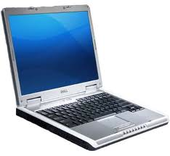
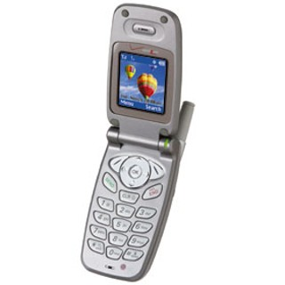
The Rules
(and we really mean it!)

Slide 11
Architecture of a Lecture
Full
Administrivia
Tech
break
“And in
conclusion…”
Attention
0
20
25
50
53
78
80
Time (minutes)

Slide 12


Peer Instruction
Increase real-time learning in lecture, test understanding of concepts vs. details
mazur-www.harvard.edu/education/pi.phtml
As complete a “segment”
ask multiple choice question
  <1 minute: decide yourself, vote
  <2 minutes: discuss in pairs,
  then team vote; flash card to pick answer
    Try to convince partner; learn by teaching
Mark and save flash cards
1
2
3
4

Slide 13
Lecture & Section
Section
Office hours & locations on homepage
  Instructor & GSI office hours: concept/HW help
  Staffed lab hours (TBA): programming help and hackfests

Slide 14
Meet the staff
The GSIs are Michael Driscoll, Richard Xia
Lab staff are Allen Chen, David Eliahu, Omer Spillinger, and Richard Zhao

Slide 15
Outline
Class Organization (AF)
Engineering SW is Different from HW
(Next 5 slides, Book Sections 1.1-1.2 or §1.1-§1.2)
Development Processes: Waterfall vs. Agile (§1.3)
Assurance (§1.4)
Productivity (§1.5)
Software as a Service (§1.6) if time permits
Service Oriented Architecture (§1.7) if time permits
Cloud Computing (§1.8) if time permits

Slide 16
Engineering Software is Different from Engineering Hardware
(Engineering Long Lasting Software §1.1-§1.2)
David Patterson
Notes:
earliest ever lecture prep! aug 4
follow along download slides

Slide 17
Engineering Software is Different from Hardware
Q: Why so many SW disasters and
no HW disasters?
  Ariane 5 rocket explosion
  Therac-25 lethal radiation overdose
  Mars Climate Orbiter disintegration
  FBI Virtual Case File project abandonment
A: Nature of 2 media & subsequent cultures
Notes:
June 4, 1996 -- Ariane 5 Flight 501. Working code for the Ariane 4 rocket is reused in the Ariane 5, but the Ariane 5's faster engines trigger a bug in an arithmetic routine inside the rocket's flight computer. The error is in the code that converts a 64-bit floating-point number to a 16-bit signed integer. The faster engines cause the 64-bit numbers to be larger in the Ariane 5 than in the Ariane 4, triggering an overflow condition that results in the flight computer crashing.
First Flight 501's backup computer crashes, followed 0.05 seconds later by a crash of the primary computer. As a result of these crashed computers, the rocket's primary processor overpowers the rocket's engines and causes the rocket to disintegrate 40 seconds after launch.
From wired Magazine, History's Worst Software Bugs, 2005, http://www.wired.com/software/coolapps/news/2005/11/69355?currentPage=2

Slide 18
Independent Products vs. Continuous Improvement
Cost of field upgrade
HW ≈ ∞
  HW designs must be finished before manufactured and shipped
  Bugs: Return HW (lose if many returns)
SW ≈ 0
  Expect SW gets better over time
  Bugs: Wait for upgrade
HW decays, SW long lasting
Notes:
Fill in ~infinite for HW
Fill in ~0 for SW

Slide 19
Independent Products vs. Continuous Improvement
Cost of field upgrade
HW_______
  HW designs must be finished before manufactured and shipped
  Bugs: Return HW (lose if many returns)
SW_______
  Expect SW gets better over time
  Bugs: Wait for upgrade
HW decays, SW long lasting
Notes:
Fill in ~infinite for HW
Fill in ~0 for SW

Slide 20
Legacy SW vs. Beautiful SW
Legacy code: old SW that continues to meet customers' needs, but difficult to evolve due to design inelegance or antiquated technology
  60% SW maintenance costs adding new functionality to legacy SW
  17% for fixing bugs
Contrasts with beautiful code: meets customers' needs and easy to evolve
Notes:
60% SW maintenance
17% fixing bugs
Failure: Unexpectedly short-lived code
Yet Legacy SW is successful SW

Slide 21
Legacy SW vs. Beautiful SW
Legacy code: old SW that continues to meet customers' needs, but difficult to evolve due to design inelegance or antiquated technology
  ___% SW maintenance costs adding new functionality to legacy SW
  ___% for fixing bugs
Contrasts with beautiful code: meets customers' needs and easy to evolve
Notes:
60% SW maintenance
17% fixing bugs
Failure: Unexpectedly short-lived code
Yet Legacy SW is successful SW

Slide 22
Legacy Code: Key but Ignored
Missing from traditional SWE courses and textbooks
Number 1 request from industry experts we asked: What should be in new SWE course?
NEW: assignment to enhance legacy code in 2nd half of Berkley course

Slide 23
Question: Which type of SW is considered an epic failure?
☐
Beautiful code
☐
Legacy code
☐
Unexpectedly short-lived code
☐
Both legacy code and unexpectedly short lived code
Notes:
VertLeftWhiteCheck1
Failure: Unexpectedly short-lived code
Legacy SW is successful SW

Slide 24
Development processes:
Waterfall vs. Agile
(Engineering Long Lasting Software §1.3)
David Patterson
Notes:
earliest ever lecture prep! aug 4
follow along download slides

Slide 25
Development Processes:
Waterfall vs. Agile
Waterfall “lifecycle” or development process
  A.K.A. “Big Design Up Front” or BDUF
Requirements analysis and specification
Architectural design
Implementation and Integration
Verification
Operation and Maintenance
Complete one phase before start next one
  Why? Earlier catch bug, cheaper it is
  Extensive documentation/phase for new people

Slide 26
How well does Waterfall work?
Works well for important software with specs that won’t change: NASA spacecraft, aircraft control, …
But often when customer sees result, wants big changes
But often after built first one, developers learn right way they should have built it

Slide 27
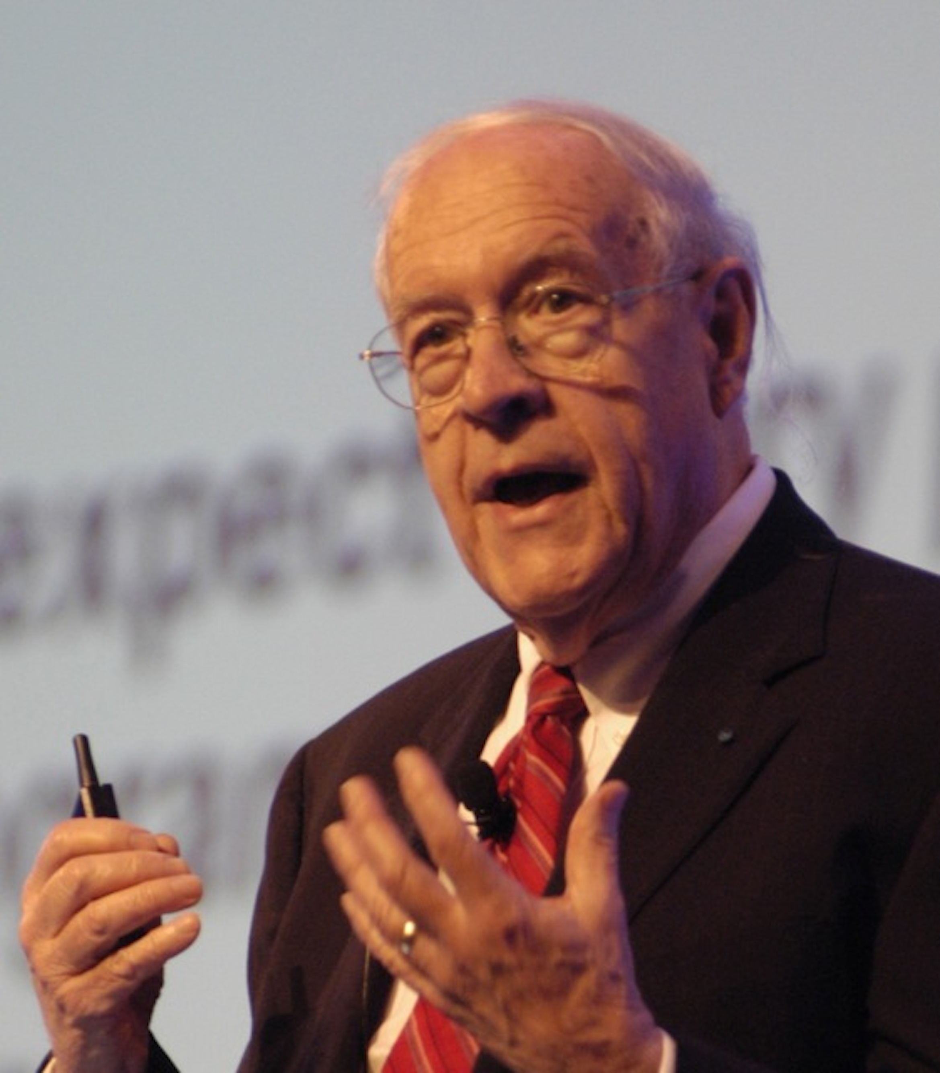
How well does Waterfall work?
“Plan to throw one [implementation] away; you will, anyhow.”
Fred Brooks, Jr.
(received 1999 Turing Award for
contributions to computer
architecture, operating systems,
and software engineering)
(Photo by Carola Lauber of SD&M www.sdm.de. Used by permission under CC-BY-SA-3.0.)

Slide 28
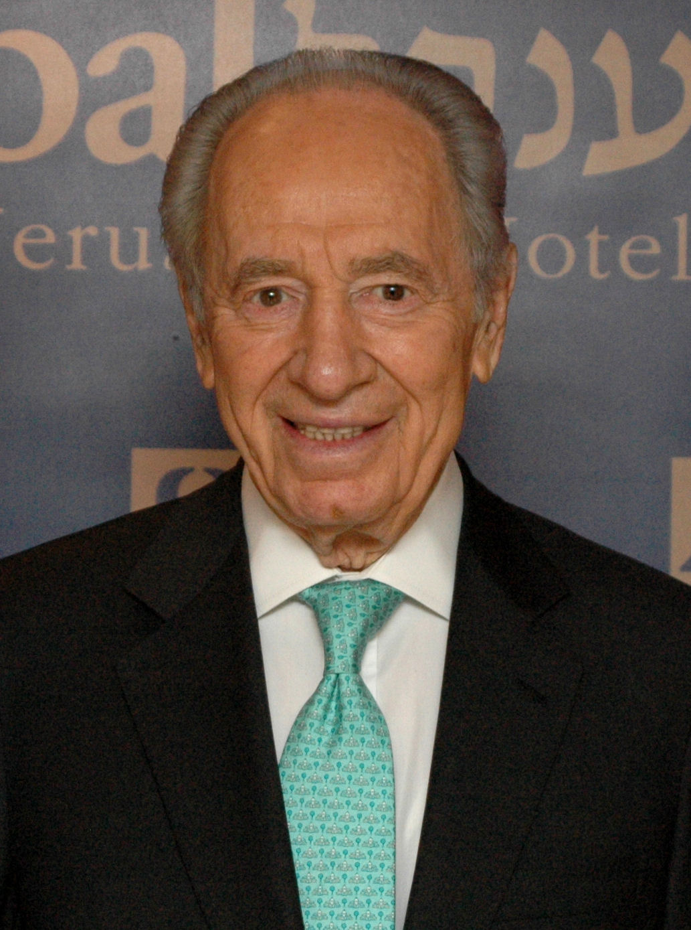
Peres’s Law
“If a problem has no solution,
it may not be a problem,
but a fact, not to be solved,
but to be coped with over time.”
— Shimon Peres
(winner of 1994
Nobel Peace Prize
for Oslo accords)
(Photo Source: Michael Thaidigsmann, put in public domain,
See http://en.wikipedia.org/wiki/File:Shimon_peres_wjc_90126.jpg)

Slide 29
Agile Manifesto, 2001
“We are uncovering better ways of developing SW by doing it and helping others do it. Through this work we have come to value
Individuals and interactions over processes & tools
Working software over comprehensive documentation
Customer collaboration over contract negotiation
Responding to change over following a plan
That is, while there is value in the items on the right, we value the items on the left more.”

Slide 30
Agile Manifesto, 2001
“We are uncovering better ways of developing SW by doing it and helping others do it. Through this work we have come to value
Individuals and interactions over processes & tools
Working software over comprehensive documentation
Customer collaboration over contract negotiation
Responding to change over following a plan
That is, while there is value in the items on the right, we value the items on the left more.”

Slide 31
Agile lifecycle
Embraces change as a fact of life: continuous improvement vs. phases
Developers continuously refine working but incomplete prototype until customers happy, with customer feedback on each Iteration
(every ~2 weeks)
Agile emphasizes Test-Driven Development (TDD) to reduce mistakes, written down User Stories to validate customer requirements, Velocity to measure progress

Slide 32
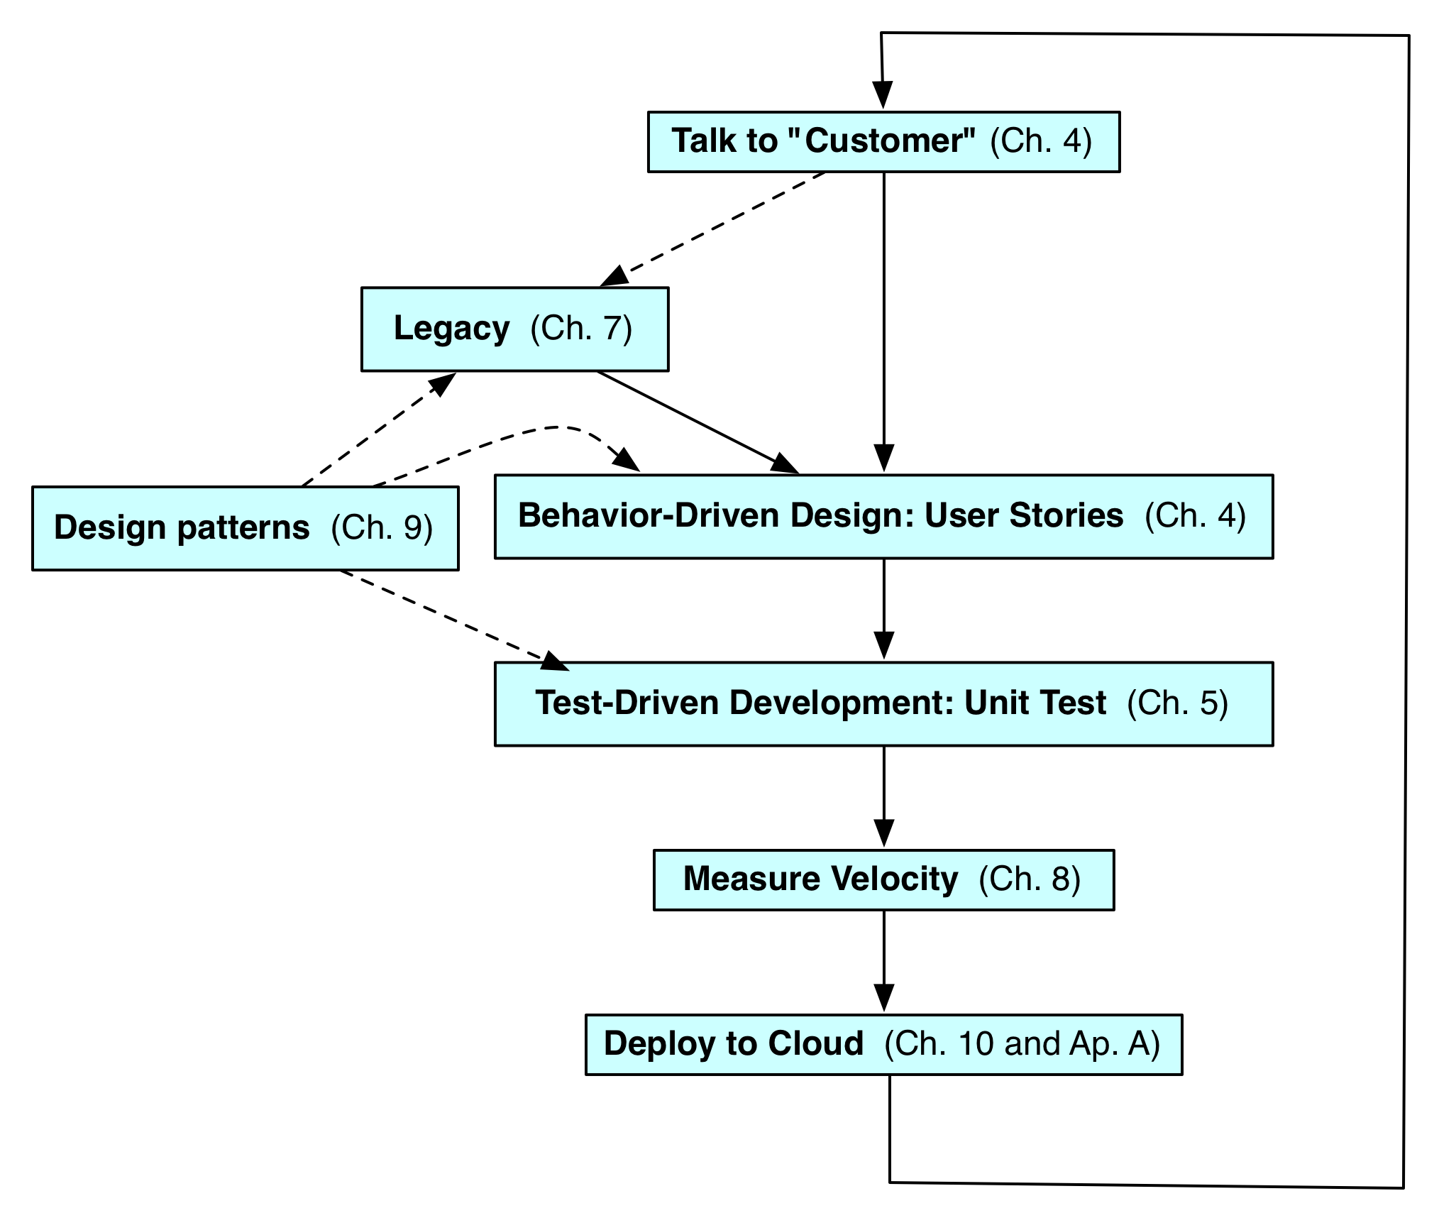
Agile Iteration/
Book Organization
(Figure 1.4, Engineering Long Lasting Software by Armando Fox and David Patterson, Alpha edition, 2012.)

Slide 33
Question: What is NOT a key difference between Waterfall and Agile lifecycles?
☐
Waterfall uses long sequential phases, Agile uses quick iterations
☐
Waterfall has no working code until end, Agile has working each code iteration
☐
Waterfall uses written requirements, but Agile does not use anything written down
☐
Waterfall has an architectural design phase, but you cannot incorporate SW architecture into the Agile lifecycle
Notes:
VertLeftWhiteCheck1
Waterfall uses written requirements, but Agile does not use anything written down is the answer to question

Slide 34
Assurance:
Testing and Formal Methods
(Engineering Long Lasting Software §1.4)
David Patterson
Notes:
earliest ever lecture prep! aug 4
follow along download slides

Slide 35
Assurance
Verification: Did you build the thing right?
  Did you meet the specification?
Validation: Did you build the right thing?
  Is this what the customer wants?
  Is the specification correct?
Hardware focus generally Verification
Software focus generally Validation
2 options: Testing and Formal Methods
Notes:
HW on verification
SW on validation

Slide 36
Assurance
Verification: Did you build the thing right?
  Did you meet the specification?
Validation: Did you build the right thing?
  Is this what the customer wants?
  Is the specification correct?
Hardware focus generally____________
Software focus generally___________
2 options: Testing and Formal Methods
Notes:
HW on verification
SW on validation

Slide 37
Testing
Exhaustive testing infeasible
Divide and conquer: perform different tests at different phases of SW development
  Upper level doesn’t redo tests of lower level
__________________test: integrated program meets its specifications
___________test: interfaces between units have consistent assumptions, communicate correctly
_________________test: across individual units
___test: single method does what was expected
Notes:
e.g., unit testing works within a single class and functional testing works across classes
System or acceptance test: integrated program meets its specifications
Integration test: interfaces between units have consistent assumptions, communicate correctly
Module or functional test: across individual units
Unit test: single method does what was expected

Slide 38
Testing
Exhaustive testing infeasible
Divide and conquer: perform different tests at different phases of SW development
  Upper level doesn’t redo tests of lower level
System or acceptance test: integrated program meets its specifications
Integration test: interfaces between units have consistent assumptions, communicate correctly
Module or functional test: across individual units
Unit test: single method does what was expected
Notes:
e.g., unit testing works within a single class and functional testing works across classes
System or acceptance test: integrated program meets its specifications
Integration test: interfaces between units have consistent assumptions, communicate correctly
Module or functional test: across individual units
Unit test: single method does what was expected

Slide 39
More Testing
Coverage: % of code paths tested
Regression Testing: automatically rerun old tests so changes don’t break what used to work
Continuous Integration Testing: continuous regression testing vs. later phases
Agile => Test Driven Design (TDD)
write tests before you write the code you wish you had (tests drive coding)

Slide 40

Limits of Testing
Program testing can be used to show the presence of bugs, but never to show their absence!
  Edsger W. Dijkstra
  (received the 1972 Turing Award for
  fundamental contributions to
  developing programming languages)
(Photo by Hamilton Richards. Used by permission under CC-BY-SA-3.0.)

Slide 41
Formal Methods
Start with formal specification & prove program behavior follows spec. Options:
Human does proof
Computer via automatic theorem proving
  Uses inference + logical axioms to produce proofs from scratch
Computer via model checking
  Verifies selected properties by exhaustive search of all possible states that a system could enter during execution

Slide 42
Formal Methods
Computationally expensive, so use only if
  Small, fixed function
  Expensive to repair, very hard to test
  E.g., Network protocols, safety critical SW
Biggest: OS kernel 10K LOC @ $500/LOC
  NASA SW $80/LOC
This course: rapidly changing SW, easy to repair, easy to test => no formal methods
  Discuss again on future of engineering SW

Slide 43
Question: Which statement is NOT true about testing?
☐
With better test coverage, you are more likely to catch faults
☐
While difficult to achieve, 100% test coverage insures design reliability
☐
Each higher level test delegates more detailed testing to lower levels
☐
Unit testing works within a single class and module testing works across classes
Notes:
VertLeftWhiteCheck1
Answer: While difficult to achieve, 100% test coverage insures design reliability

Slide 44
Productivity: Conciseness, Synthesis, Reuse, and Tools
(Engineering Long Lasting Software §1.5)
David Patterson
Notes:
earliest ever lecture prep! aug 4
follow along download slides

Slide 45
Productivity
Moore’s Law => 2X transistors/1.5 years
  HW designs get bigger
  Faster processors and bigger memories
  SW designs get bigger
  Must improve HW & SW productivity
4 techniques
  Clarity via conciseness
  Synthesis
  Reuse
  Automation and Tools

Slide 46
Clarity via conciseness
Syntax: shorter and easier to read
assert_greater_than_or_equal_to(a,7)
vs. a.should be ≥ 7
Raise the level of abstraction:
  HLL programming languages vs. assembly lang
  Automatic memory management (Java vs.C)
  Scripting languages: reflection, metaprogramming
Notes:
a.should be ≥ 7

Slide 47
Clarity via conciseness
Syntax: shorter and easier to read
assert_greater_than_or_equal_to(a,7)
vs. ________________
Raise the level of abstraction:
  HLL programming languages vs. assembly lang
  Automatic memory management (Java vs.C)
  Scripting languages: reflection, metaprogramming
Notes:
a.should be ≥ 7

Slide 48
Synthesis
Software synthesis
  BitBlt: generate code to fit situation & remove conditional test
Future Research: Programming by example

Slide 49
Reuse
Reuse old code vs. write new code
Techniques in historical order:
Procedures and functions
Standardized libraries (reuse single task)
Object oriented programming: reuse and manage collections of tasks
Design patterns: reuse a general strategy even if implementation varies

Slide 50
Automation and Tools
Replace tedious manual tasks with automation to save time, improve accuracy
  New tool can make lives better (e.g., make)
Concerns with new tools: Dependability, UI quality, picking which one from several
We think good software developer must repeatedly learn how to use new tools
  Lots of chances in this course:
  Cucumber, RSpec, Pivotal Tracker, …

Slide 51
Question: Which statement is TRUE about productivity?
☐
Copy and pasting code is another good way to get reuse
☐
Metaprogramming helps productivity via program synthesis
☐
Of the 4 productivity reasons, the primary one for HLL is reuse
☐
A concise syntax is more likely to have fewer bugs and be easier to maintain
Notes:
VertLeftWhiteCheck1
TRUE: Metaprogramming helps productivity via program synthesis

Slide 52
DRY
“Every piece of knowledge must have a single, unambiguous, authoritative representation within a system.”
  Andy Hunt and Dave Thomas, 1999
Don't Repeat Yourself (DRY)
  Don’t want to find many places have to apply same repair
Don’t copy and paste code!

Slide 53
Software as a Service (SaaS)
(Engineering Long Lasting Software §1.6)
David Patterson
Notes:
earliest ever lecture prep! aug 4
follow along download slides

Slide 54
Software as a Service: SaaS
Traditional SW: binary code installed and runs wholly on client device
SaaS delivers SW & data as service over Internet via thin program (e.g., browser) running on client device
  Search, social networking, video
Now also SaaS version of traditional SW
  E.g., Microsoft Office 365, TurboTax Online

Slide 55
6 Reasons for SaaS
No install worries about HW capability, OS
No worries about data loss (at remote site)
Easy for groups to interact with same data
If data is large or changed frequently, simpler to keep 1 copy at central site
1 copy of SW, controlled HW environment => no compatibility hassles for developers
1 copy => simplifies upgrades for developers and no user upgrade requests

Slide 56
SaaS Loves Agile & Rails
Frequent upgrades matches Agile lifecycle
Many frameworks for Agile/SaaS
We use Ruby on Rails (“Rails”)
Ruby, a modern scripting language: object oriented, functional, automatic memory management, dynamic types, reuse via mix-ins, synthesis via metaprogramming
Rails popular – e.g., Twitter

Slide 57
Which is weakest argument for a Google app’s popularity as SaaS?
☐
Don’t lose data: Gmail
☐
Cooperating group: Documents
☐
Large/Changing Dataset: YouTube
☐
No field upgrade when improve app: Search
Notes:
VertLeftWhiteCheck1
No field upgrade when improve – really it’s the data

Slide 58
Outline
Class Organization (AF)
Engineering SW is Different from HW (§1.1-§1.2)
Development Processes: Waterfall vs. Agile (§1.3)
Assurance (§1.4)
Productivity (§1.5)
Software as a Service (§1.6) if time permits
Service Oriented Architecture (§1.7) if time permits
(Next 6 slides)
Cloud Computing (§1.8) if time permits

Slide 59
Service Oriented Architecture(SOA)
(Engineering Long Lasting Software §1.7)
David Patterson
Notes:
earliest ever lecture prep! aug 4
follow along download slides

Slide 60
Service Oriented Architecture
SOA: SW architecture where all components are designed to be services
Apps composed of interoperable services
  Easy to tailor new version for subset of users
  Also easier to recover from mistake in design
Contrast to “SW silo” without internal APIs

Slide 61
CEO: Amazon shall use SOA!
“All teams will henceforth expose their data and functionality through service interfaces
Teams must communicate with each other through these interfaces
There will be no other form of interprocess communication allowed: no direct linking, no direct reads of another team's data store, no shared-memory model, no back-doors whatsoever. The only communication allowed is via service interface calls over the network.

Slide 62
CEO: Amazon shall use SOA!
It doesn't matter what [API protocol] technology you use.
Service interfaces, without exception, must be designed from the ground up to be externalizable. That is to say, the team must plan and design to be able to expose the interface to developers in the outside world. No exceptions.
Anyone who doesn't do this will be fired.
Thank you; have a nice day!”

Slide 63
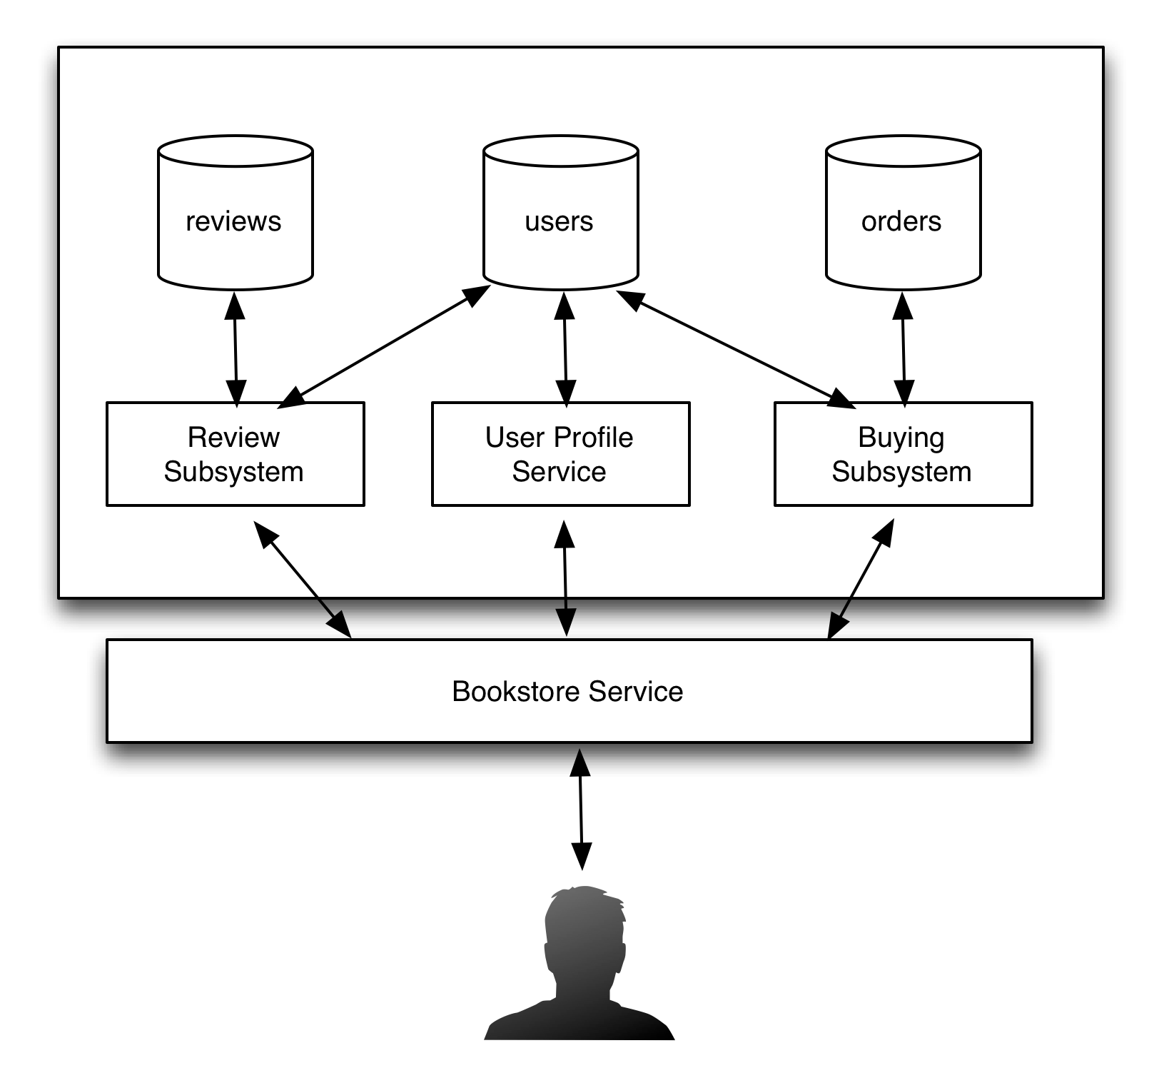

Bookstore: Silo
Internal subsystems can share data directly
  Review access user profile
All subsystems inside single API
(“Bookstore”)
(Figure 1.2, Engineering Long Lasting Software by Armando Fox and David Patterson, Alpha edition, 2012.)
Notes:
the reviews subsystem can get user profile info out of the users subsystem

Slide 64
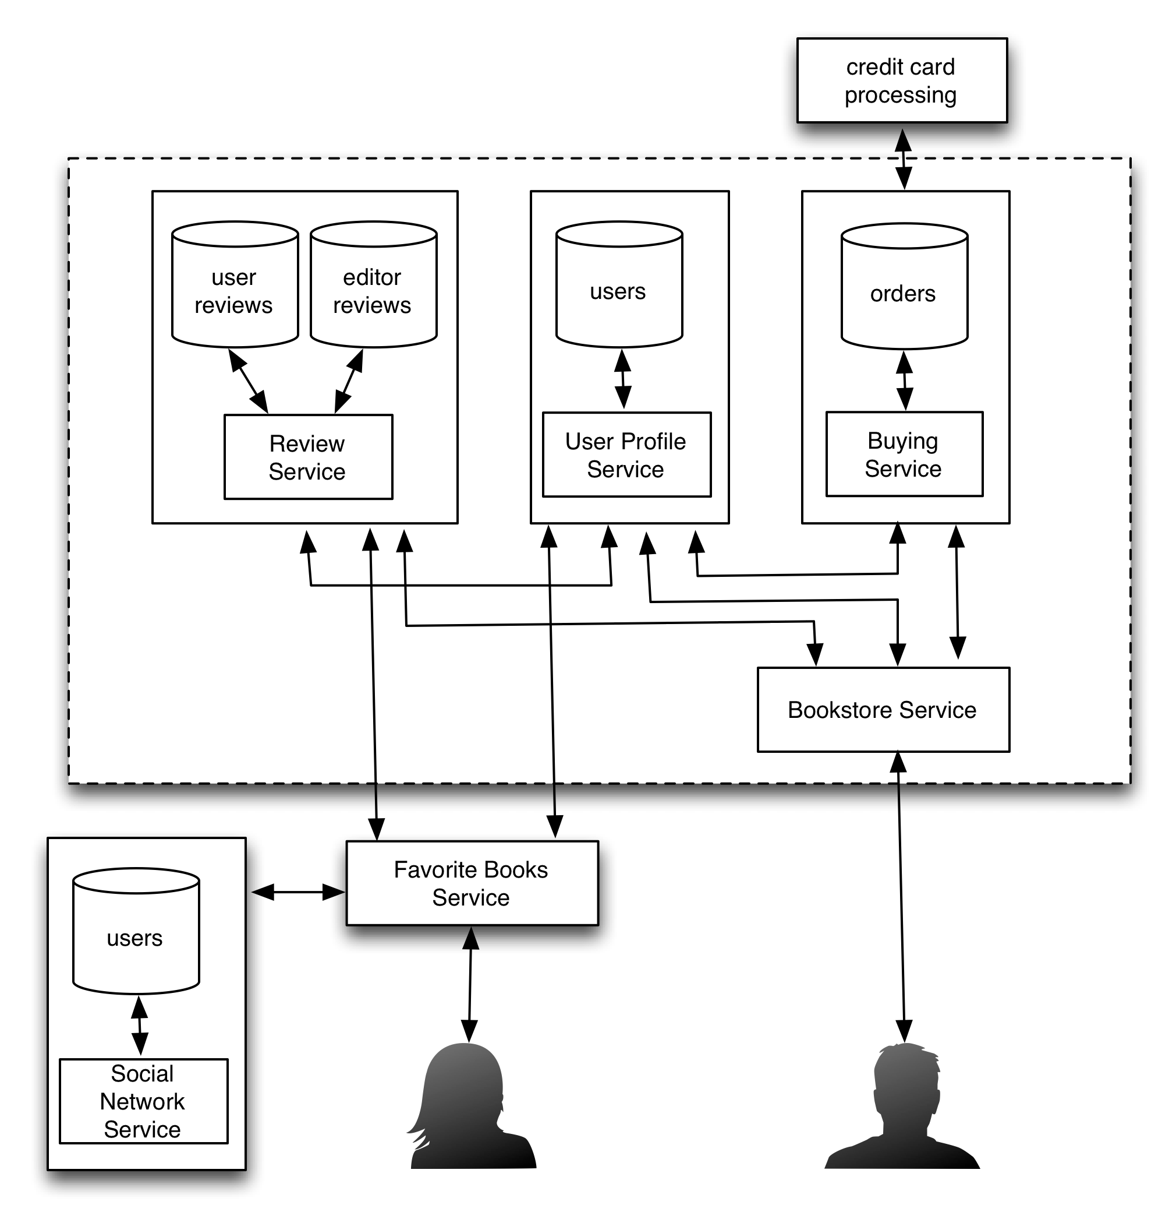
Bookstore: SOA
Subsystems independent,
as if in separate datacenters
  Review Service access User Service API
Can recombine to make new service (“Favorite Books”)
(Figure 1.3, Engineering Long Lasting Software by Armando Fox and David Patterson, Alpha edition, 2012.)

Slide 65
Which statements NOT true about SOA?
☐
Debugging is easier with SOA
☐
Security can be harder with SOA
☐
SOA improves developer productivity primarily through reuse
☐
No service can name or access another service's data; it can only make requests for data thru an external API
Notes:
VertLeftWhiteCheck1
Not: with hard to debug across separate services

Slide 66
Cloud Computing, Fallacies and Pitfalls, and End of Chapter 1
(Engineering Long Lasting Software §§1.8, 1.9, 1.12)
David Patterson
Notes:
earliest ever lecture prep! aug 4
follow along download slides

Slide 67
SaaS Infrastructure?
SaaS demands on infrastructure
Communication: allow customers to interact with service
Scalability: fluctuations in demand during + new services to add users rapidly
Dependability: service and communication continuously available 24x7

Slide 68
Clusters
Clusters: Commodity computers connected by commodity Ethernet switches
More scalable than conventional servers
Much cheaper than conventional servers
  20X for equivalent vs. largest servers
Few operators for 1000s servers
  Careful selection of identical HW/SW
  Virtual Machine Monitors simplify operation
Dependability via extensive redundancy

Slide 69
Warehouse Scale Computers
Economies of scale pushed down cost of largest datacenter by factors 3X to 8X
  Purchase, house, operate 100K v. 1K computers
Traditional datacenters utilized 10% - 20%
Make profit offering pay-as-you-go use at less than your costs for as many computers as you need

Slide 70
Utility Computing /
Public Cloud Computing
Offers computing, storage, communication at pennies per hour +
No premium to scale:
  1000 computers @ 1 hour
  = 1 computer @ 1000 hours
Illusion of infinite scalability to cloud user
  As many computers as you can afford
Leading examples: Amazon Web Services, Google App Engine, Microsoft Azure

Slide 71
2012 AWS Instances & Prices
Instance | Per Hour | Ratio to Small | Compute Units | Virtual Cores | Compute Unit/ Core | Memory (GB) | Disk (GB) | Address
Standard Small | $0.085 | 1.0 | 1.0 | 1 | 1.00 | 1.7 | 160 | 32 bit
Standard Large | $0.340 | 4.0 | 4.0 | 2 | 2.00 | 7.5 | 850 | 64 bit
Standard Extra Large | $0.680 | 8.0 | 8.0 | 4 | 2.00 | 15.0 | 1690 | 64 bit
High-Memory Extra Large | $0.500 | 5.9 | 6.5 | 2 | 3.25 | 17.1 | 420 | 64 bit
High-Memory Double Extra Large | $1.200 | 14.1 | 13.0 | 4 | 3.25 | 34.2 | 850 | 64 bit
High-Memory Quadruple Extra Large | $2.400 | 28.2 | 26.0 | 8 | 3.25 | 68.4 | 1690 | 64 bit
High-CPU Medium | $0.170 | 2.0 | 5.0 | 2 | 2.50 | 1.7 | 350 | 32 bit
High-CPU Extra Large | $0.680 | 8.0 | 20.0 | 8 | 2.50 | 7.0 | 1690 | 64 bit
Cluster Quadruple Extra Large | $1.300 | 15.3 | 33.5 | 16 | 2.09 | 23.0 | 1690 | 64 bit
Eight Extra Large | $2.400 | 28.2 | 88.0 | 32 | 2.75 | 60.5 | 1690 | 64 bit

Slide 72
Supercomputer for hire
Top 500 supercomputer competition
290 Eight Extra Large (@ $2.40/hour)
= 240 TeraFLOPS
42nd/500 supercomputer @ ~$700 per hour
Credit card => can use 1000s computers
FarmVille on AWS
  Prior biggest online game 5M users
  What if startup had to build datacenter?
  4 days =1M; 2 months = 10M; 9 months = 75M
Notes:
CC2 = Cluster Compute Eight Extra Large

Slide 73
IBM Watson for Hire?
Jeopardy Champion IBM Watson
Hardware: 90 IBM Power 750 servers
  3.5 GHz 8 cores/server
90 @~$2.40/hour = ~$200/hour
Cost of human lawyer or account
For what tasks could AI be as good as highly trained person @ $200/hour?
What would this mean for society?

Slide 74
Which statements NOT true about SaaS, SOA, and Cloud Computing?
☐
Clusters are collections of commodity servers connected by LAN switches
☐
The Internet supplies the communication for SaaS
☐
Cloud computing uses HW clusters + SW layer using redundancy for dependability
☐
Private datacenters could match cost of Warehouse Scale Computers if they just purchased the same type of hardware
Notes:
VertLeftWhiteCheck1
Private datacenters cannot match cost of Warehouse Scale Computers even if they just purchased the same type of hardware, since they don’t get the economies of scale at 1000 vs 100,000 in purchasing, housing, operators

Slide 75
Fallacies and Pitfalls
Fallacy: If a software project is falling behind schedule, catch up by adding people
  Adding people actual makes it worse!
  Time for new people to learn about project
  Communication increases as project grows, which reduces time available get work done
“Adding manpower to a late software project makes it later.”
Fred Brooks, Jr. The Mythical Man Month

Slide 76
Fallacies and Pitfalls
Pitfall: Ignoring the cost of software design
  Since ≈0 cost to manufacture software, might believe ≈0 cost to remanufacture the way the customer wants
  Ignores the cost of design and test
(Is cost ~no cost of manufacturing software/data same rationale to pirate data? No one should pay for development, just for manufacturing?)

Slide 77
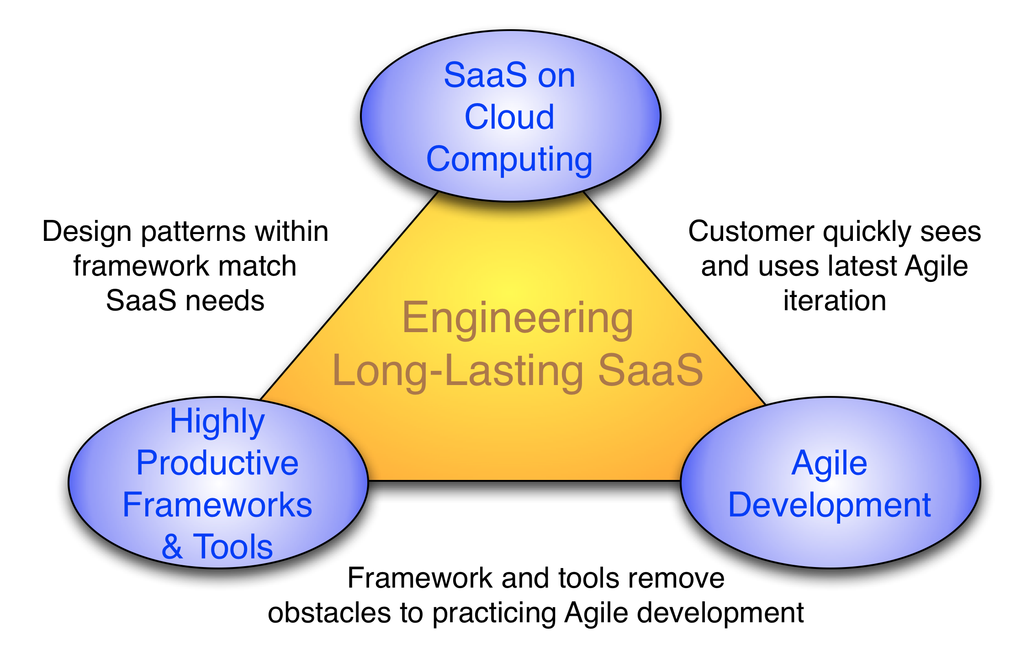
Summary: Engineering SW is More Than Programming
Long-lasting, evolvable SW vs. short life of HW led to different development processes
(Figure 1.6, Engineering Long Lasting Software by Armando Fox and David Patterson,
Alpha edition, 2012.)

